Slide 1
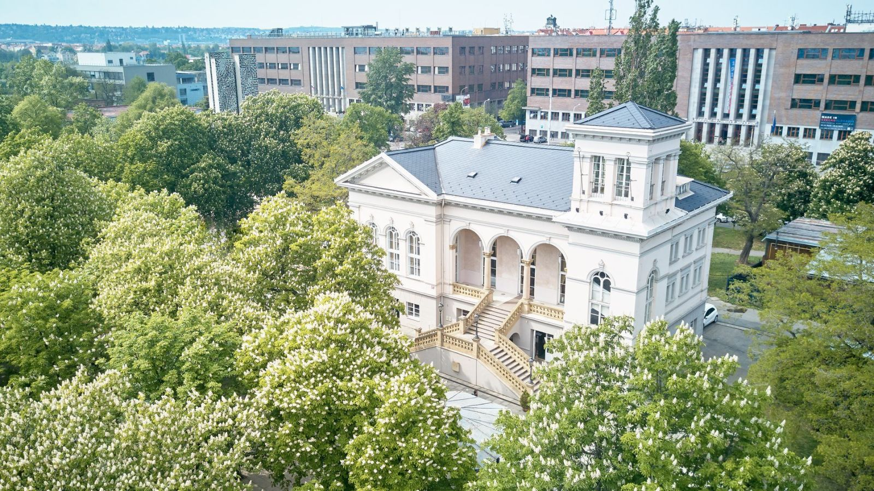
The best sights in Prague 7

Slide 2
National museums (history of the buildings)
Agriculture
Technical
Functionalism
Built in 1937-39
Architect Milan Babuška
Was not used for its purpose until 1994
After reconstruction
Functionalism
Built in 1938-41
Architect Milan Babuška
During nacism was not used for its purpose
The whole building used as museum from 1990
After recostruction

Slide 3

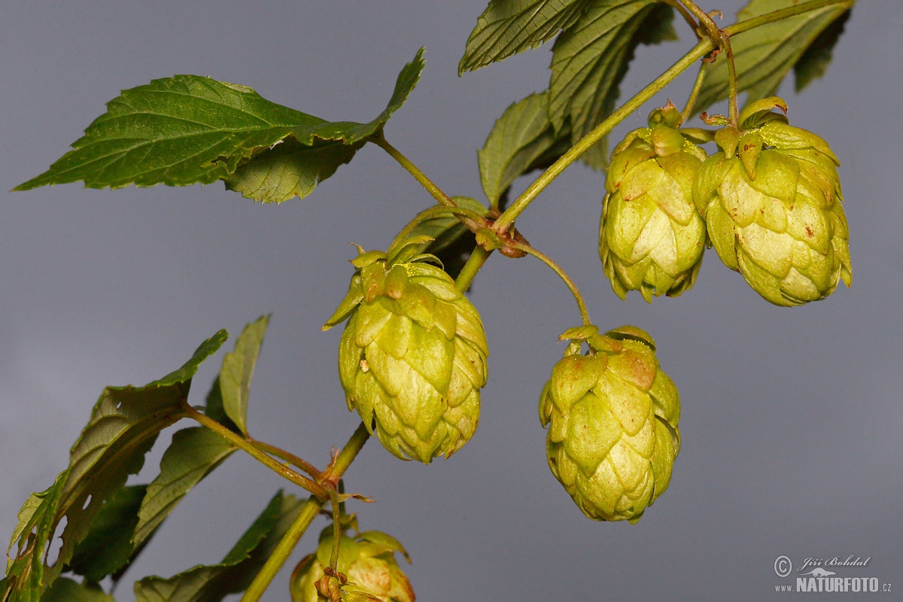
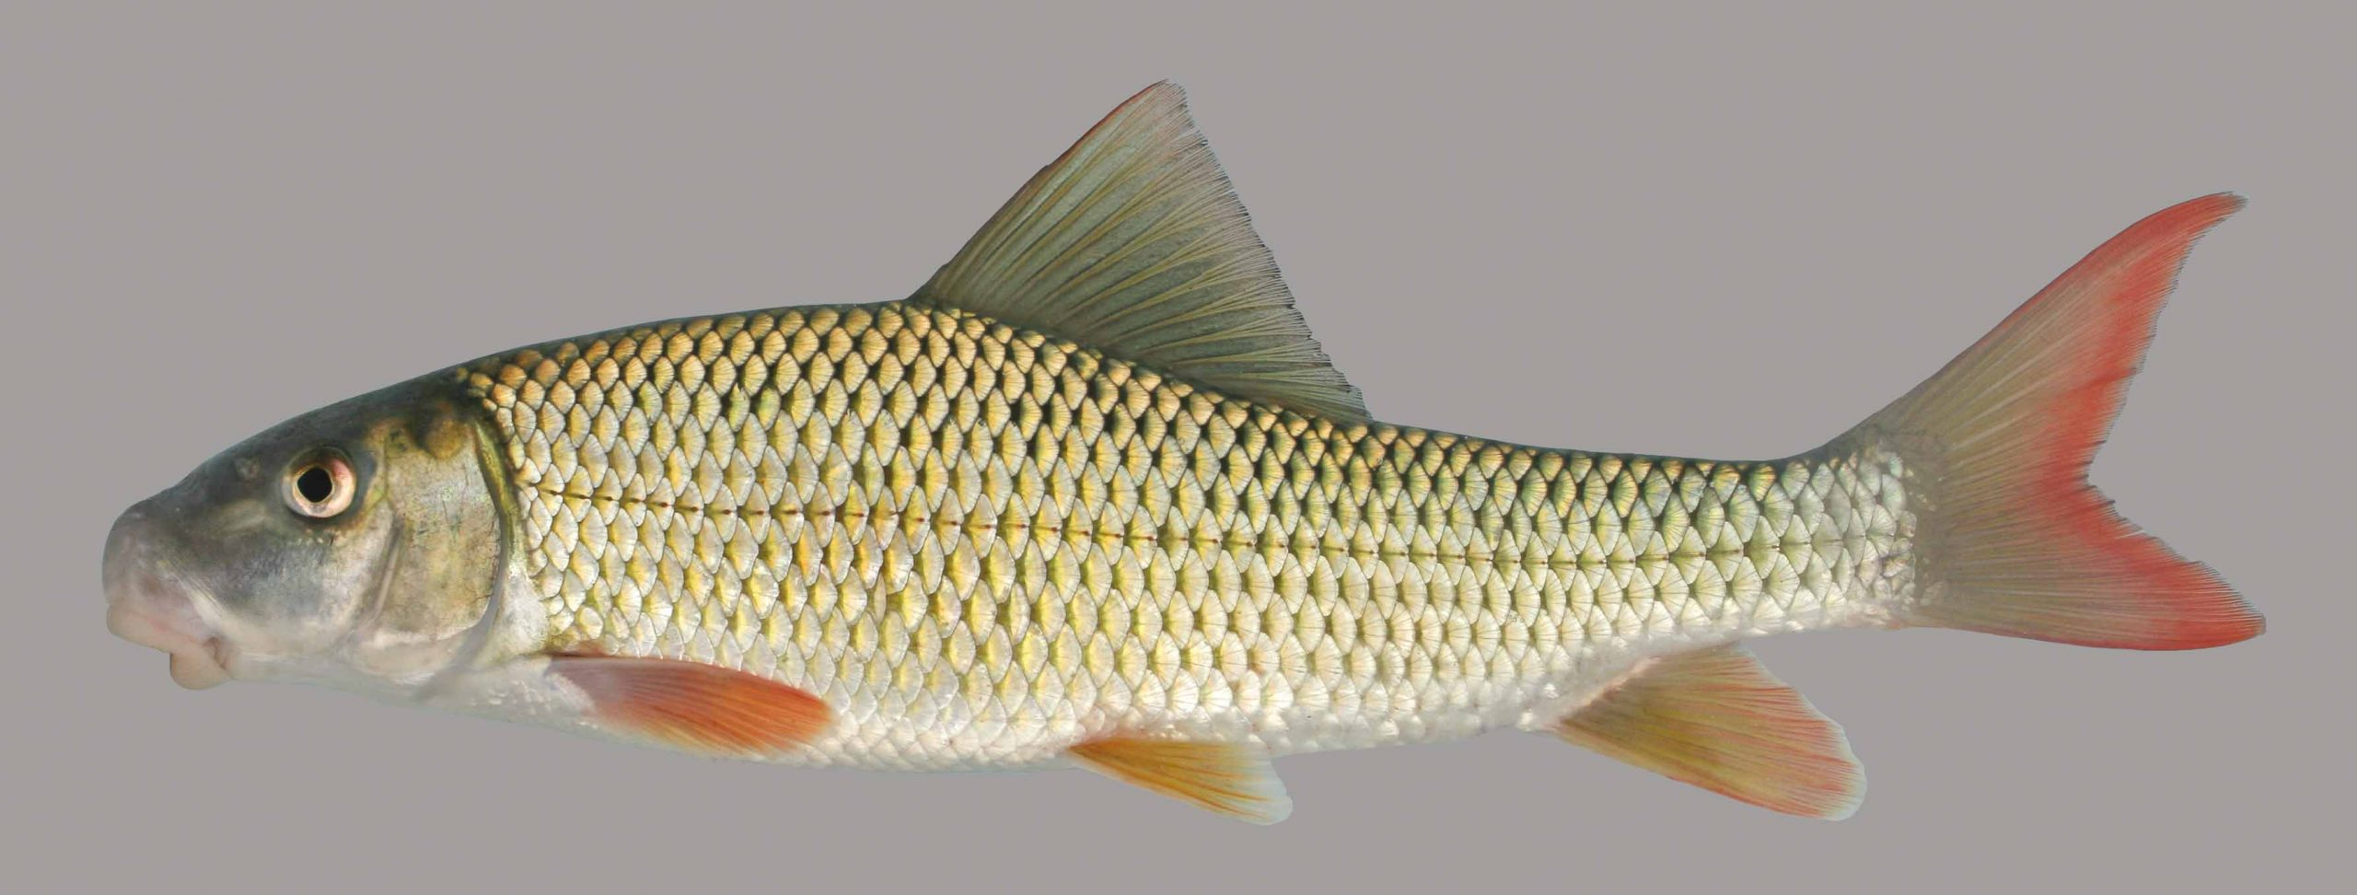
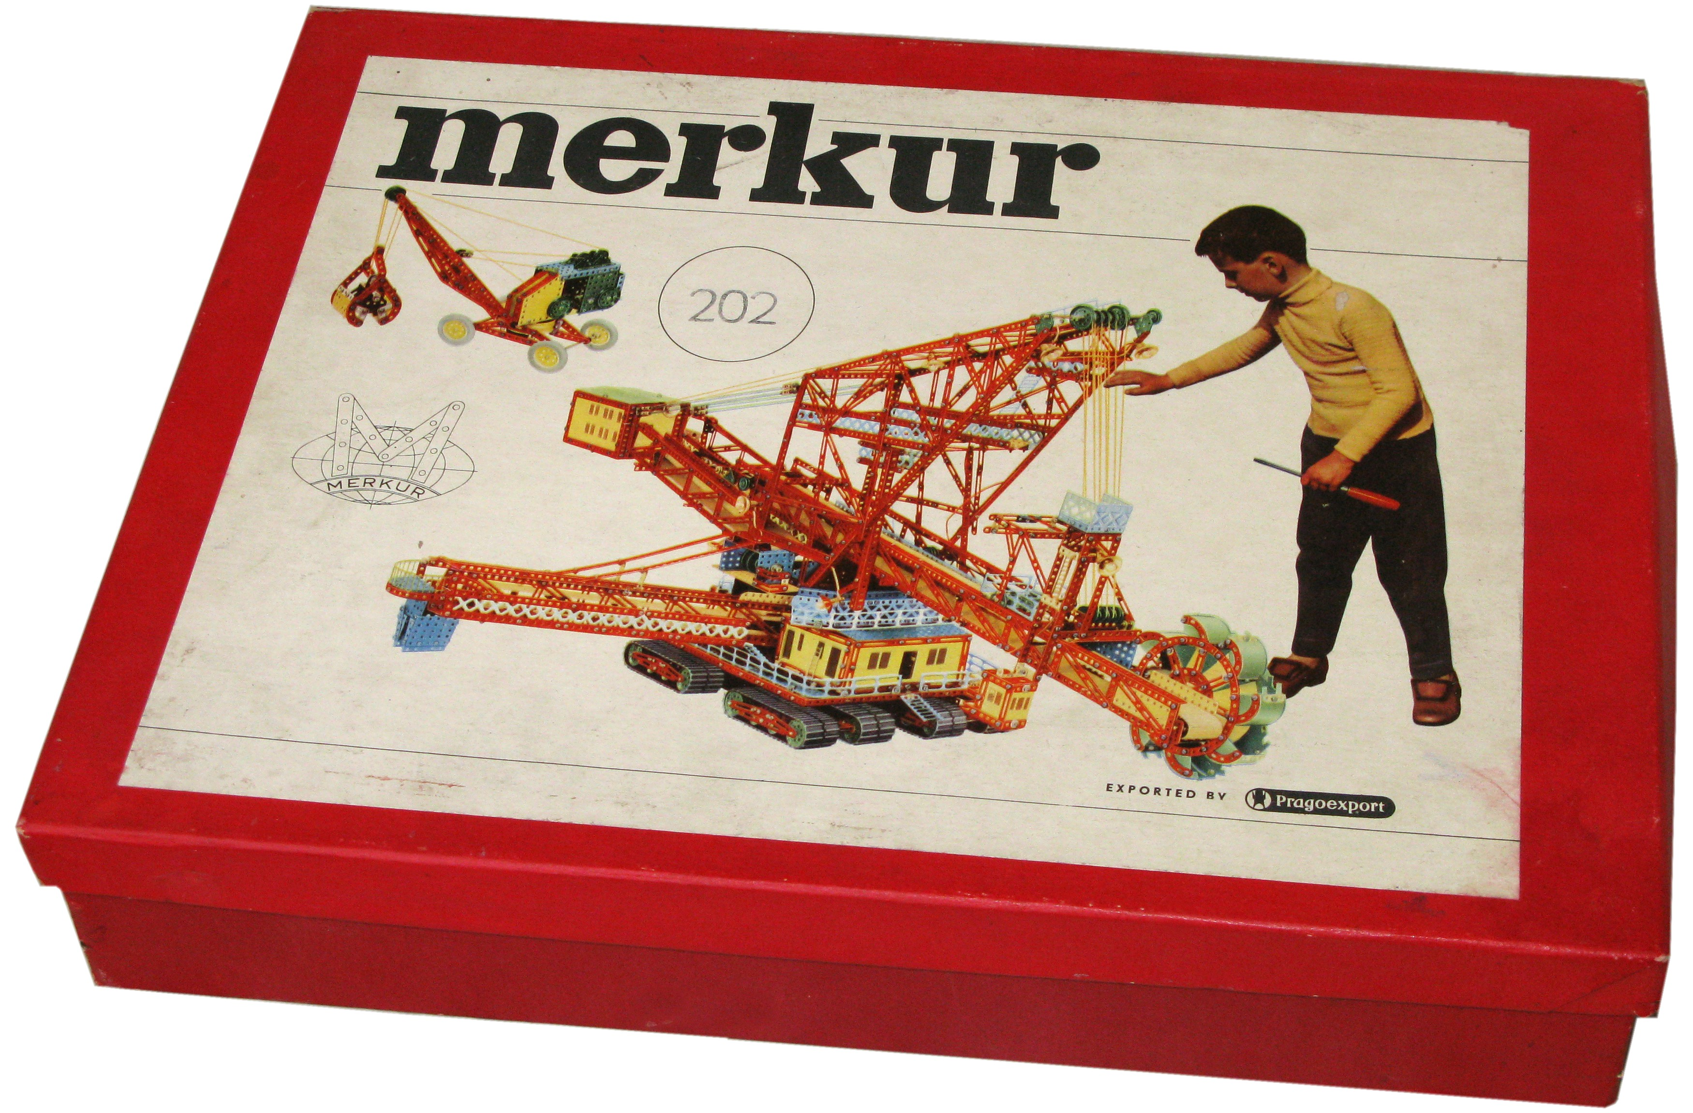

National museums (current exhibition)
Agriculture
Technical
Saaz hops
Gastronomy
Tractors
Fishing
Water in the landscape
Hunting
Transportation
Mining
Architecture
Merkur
Contact lenses
Astronomy
Time mesuring

Slide 4
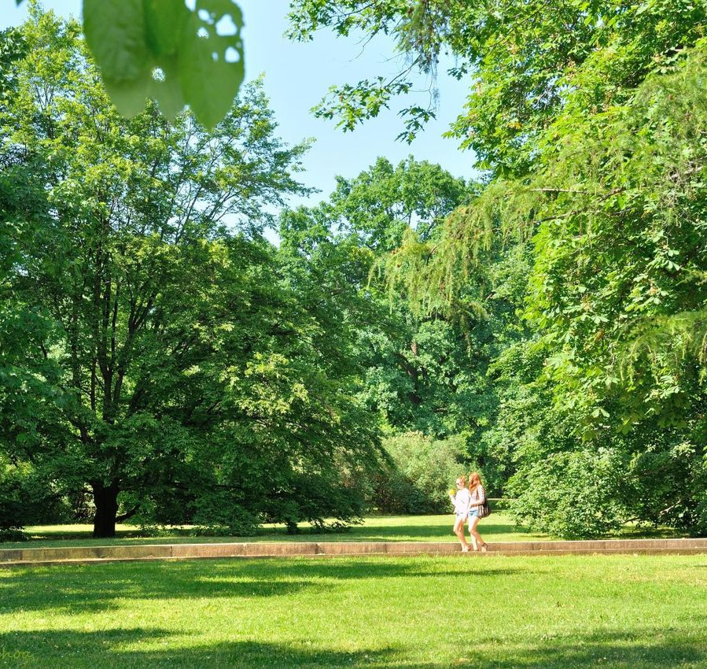
Letná Park
Big park founded by a baron Jakub Wimmer
Public since 1911
Consists of
  Letenský zámeček
  Pendulum
  Hanavian pavillion
  Brussel pavillion
  Letná Carousel

Slide 5
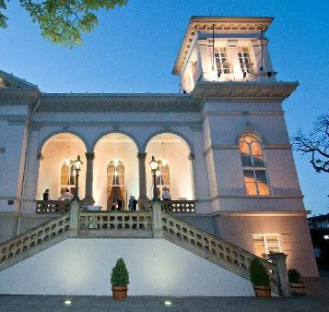
Letenský zámeček
Architect Vojtěch Ignác Ullmann
Italian countryside villa style (neo-renaissance)
Built in 1863
Next to it was built the first electric railway in Czechia

Slide 6

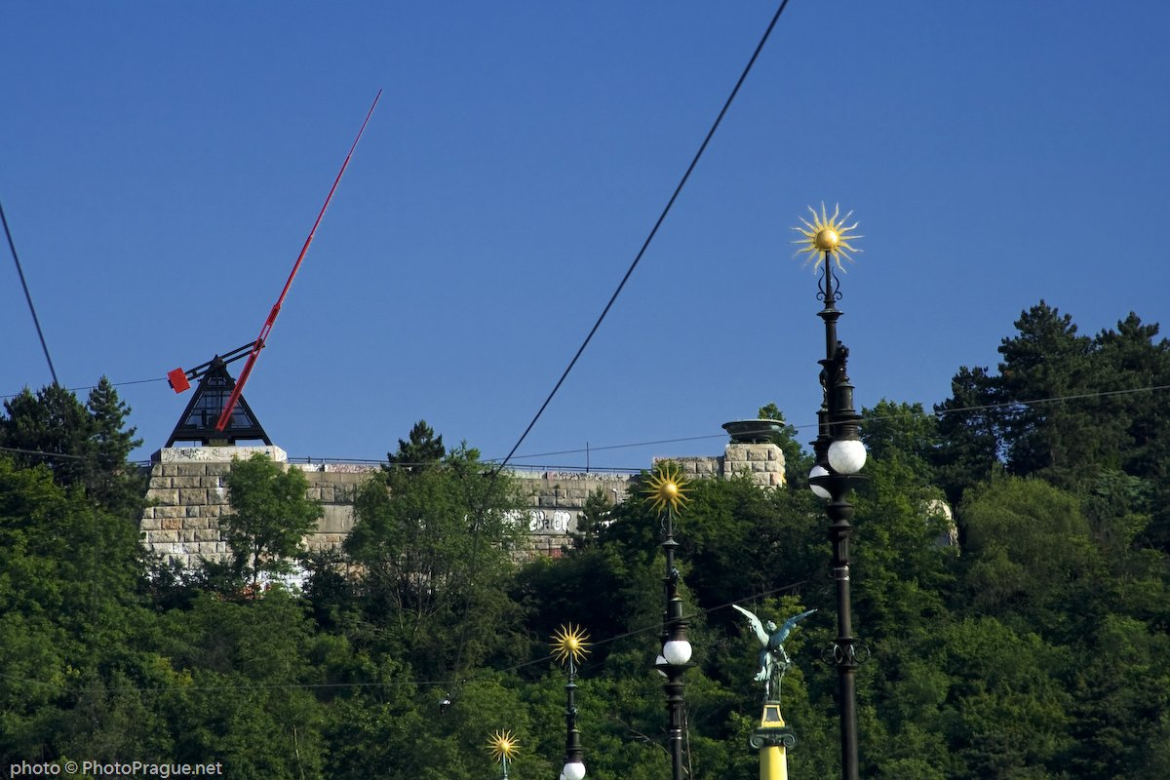
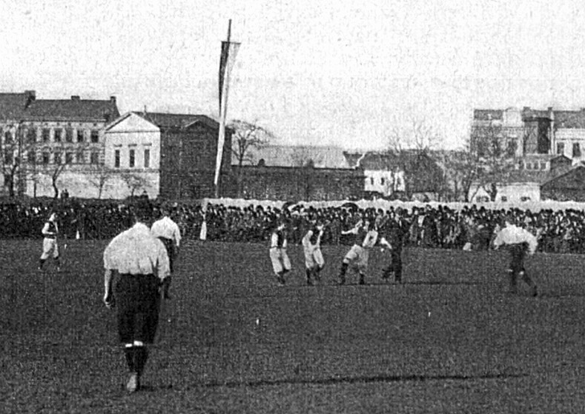
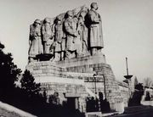
Pendulum
Slavia Sports Club Monument of Joseph Stalin Pendulum
Symbolizes how by some time,
all things pass

Slide 7
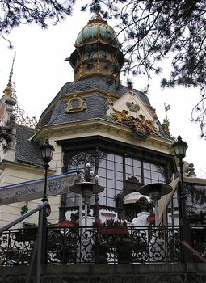
Hanavian pavillion
Buil to represent duke Vilém from Hanavaon Jubilleum on General Land Centennial Exhibition
Architects Otto Haiser a Josef Hercík
Neo-baroque style
In present there is a restaurant

Slide 8
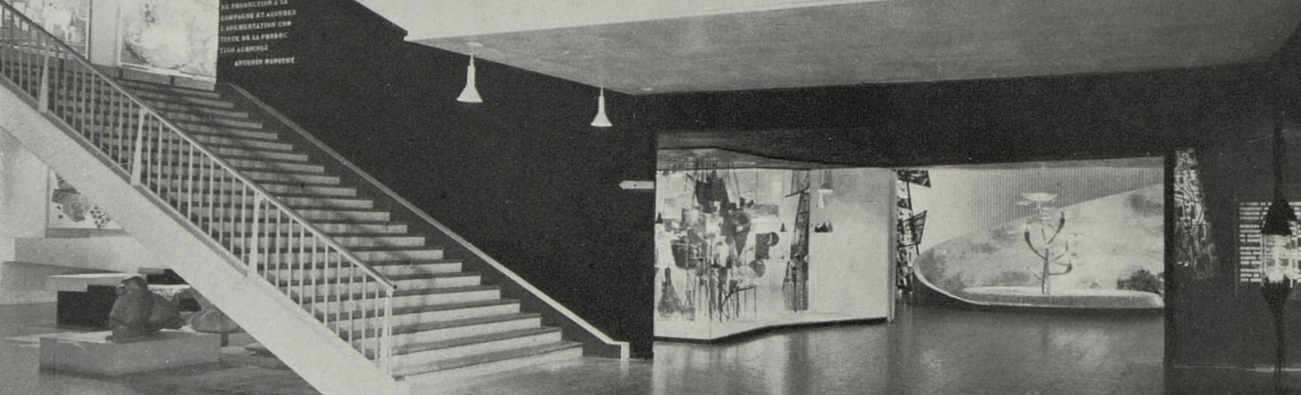
Brussel pavillion
Originally built in Brusel from wood on Expo '58
After end of Expo moved next to Výstaviště
In 1991 burned down everthing, only restaurant survived
Today is in the restaurant Adolf Loos Apartment and Gallery.

Slide 9
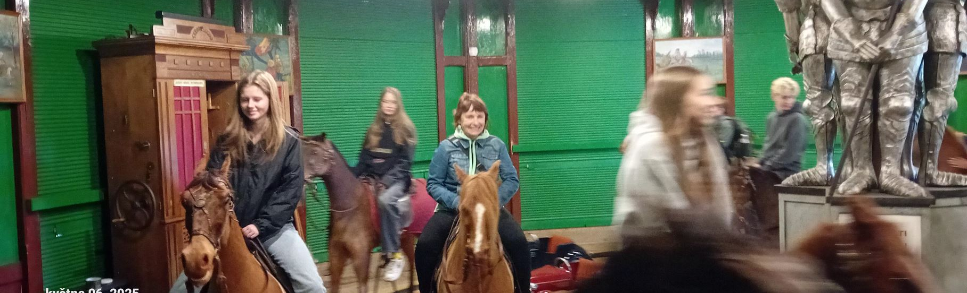
Letná Carousel
Part of National Technical Museum
Arised in 1892
Originally placed in Královské Vinohrady
Replaced to Letná in 1894
In 2022 recostructed

Slide 10
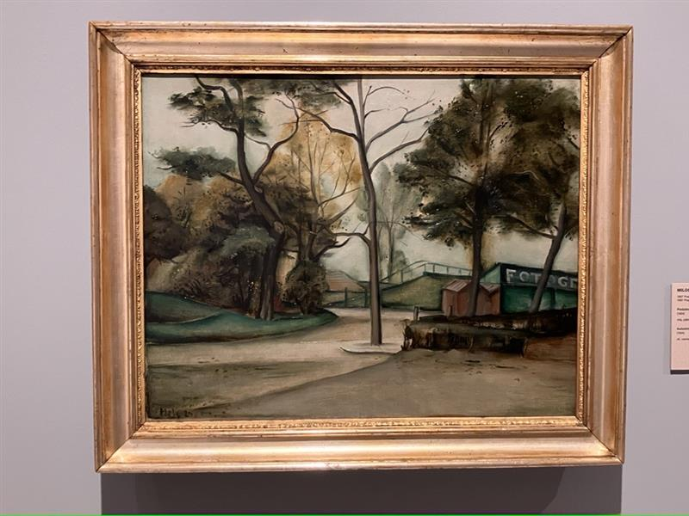
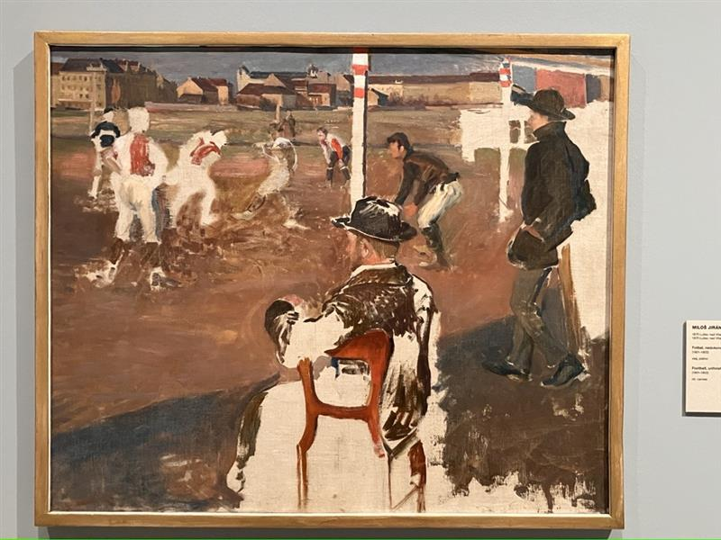
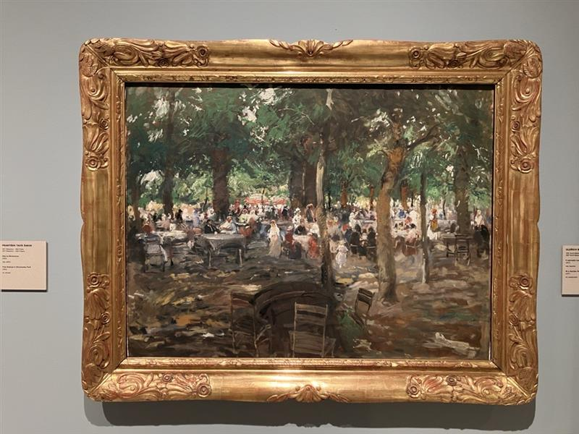
NGP

Slide 11
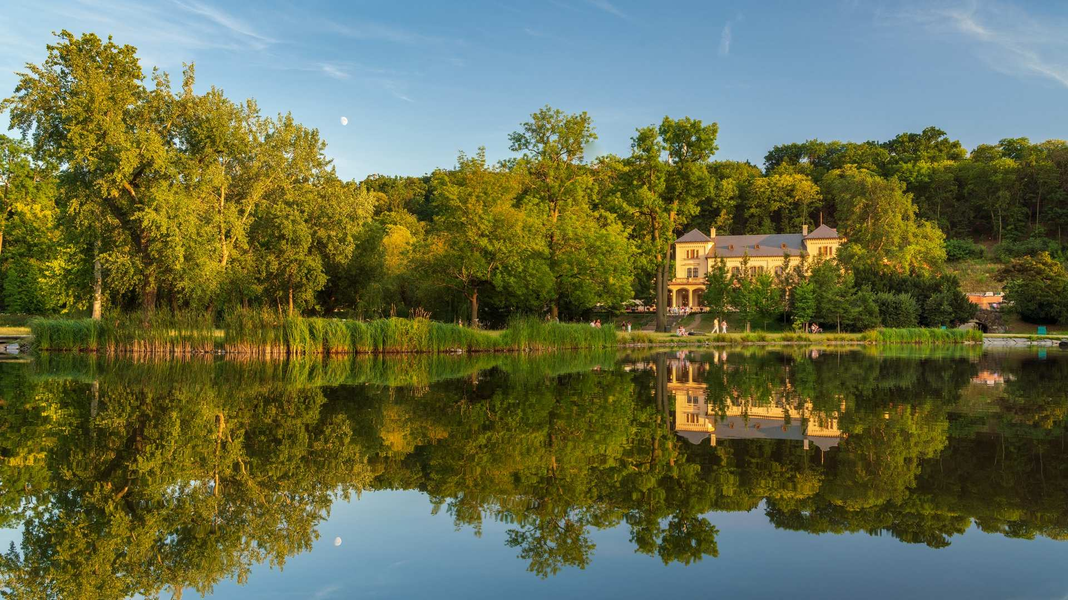
Royal Game Reserve Stromovka

Slide 12
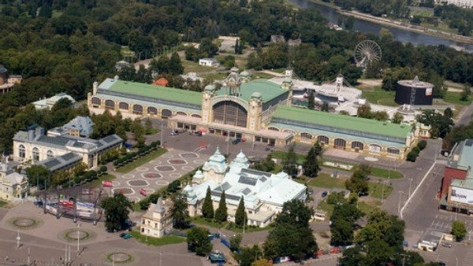
Výstaviště

Slide 13
That's all!

Slide 14
Resources searched 7. 5. 2025.
Prague Metronome - Wikipedia
Stromovka - Wikipedia
Letenský kolotoč – Wikipedie
Československý pavilon na Světové výstavě 1958 – Wikipedie
Hanavský pavilon – Wikipedie
Letenský zámeček – Wikipedie
Letenské sady – Wikipedie
Národní technické muzeum
Národní zemědělské muzeum, s. p. o.

