Slide 1
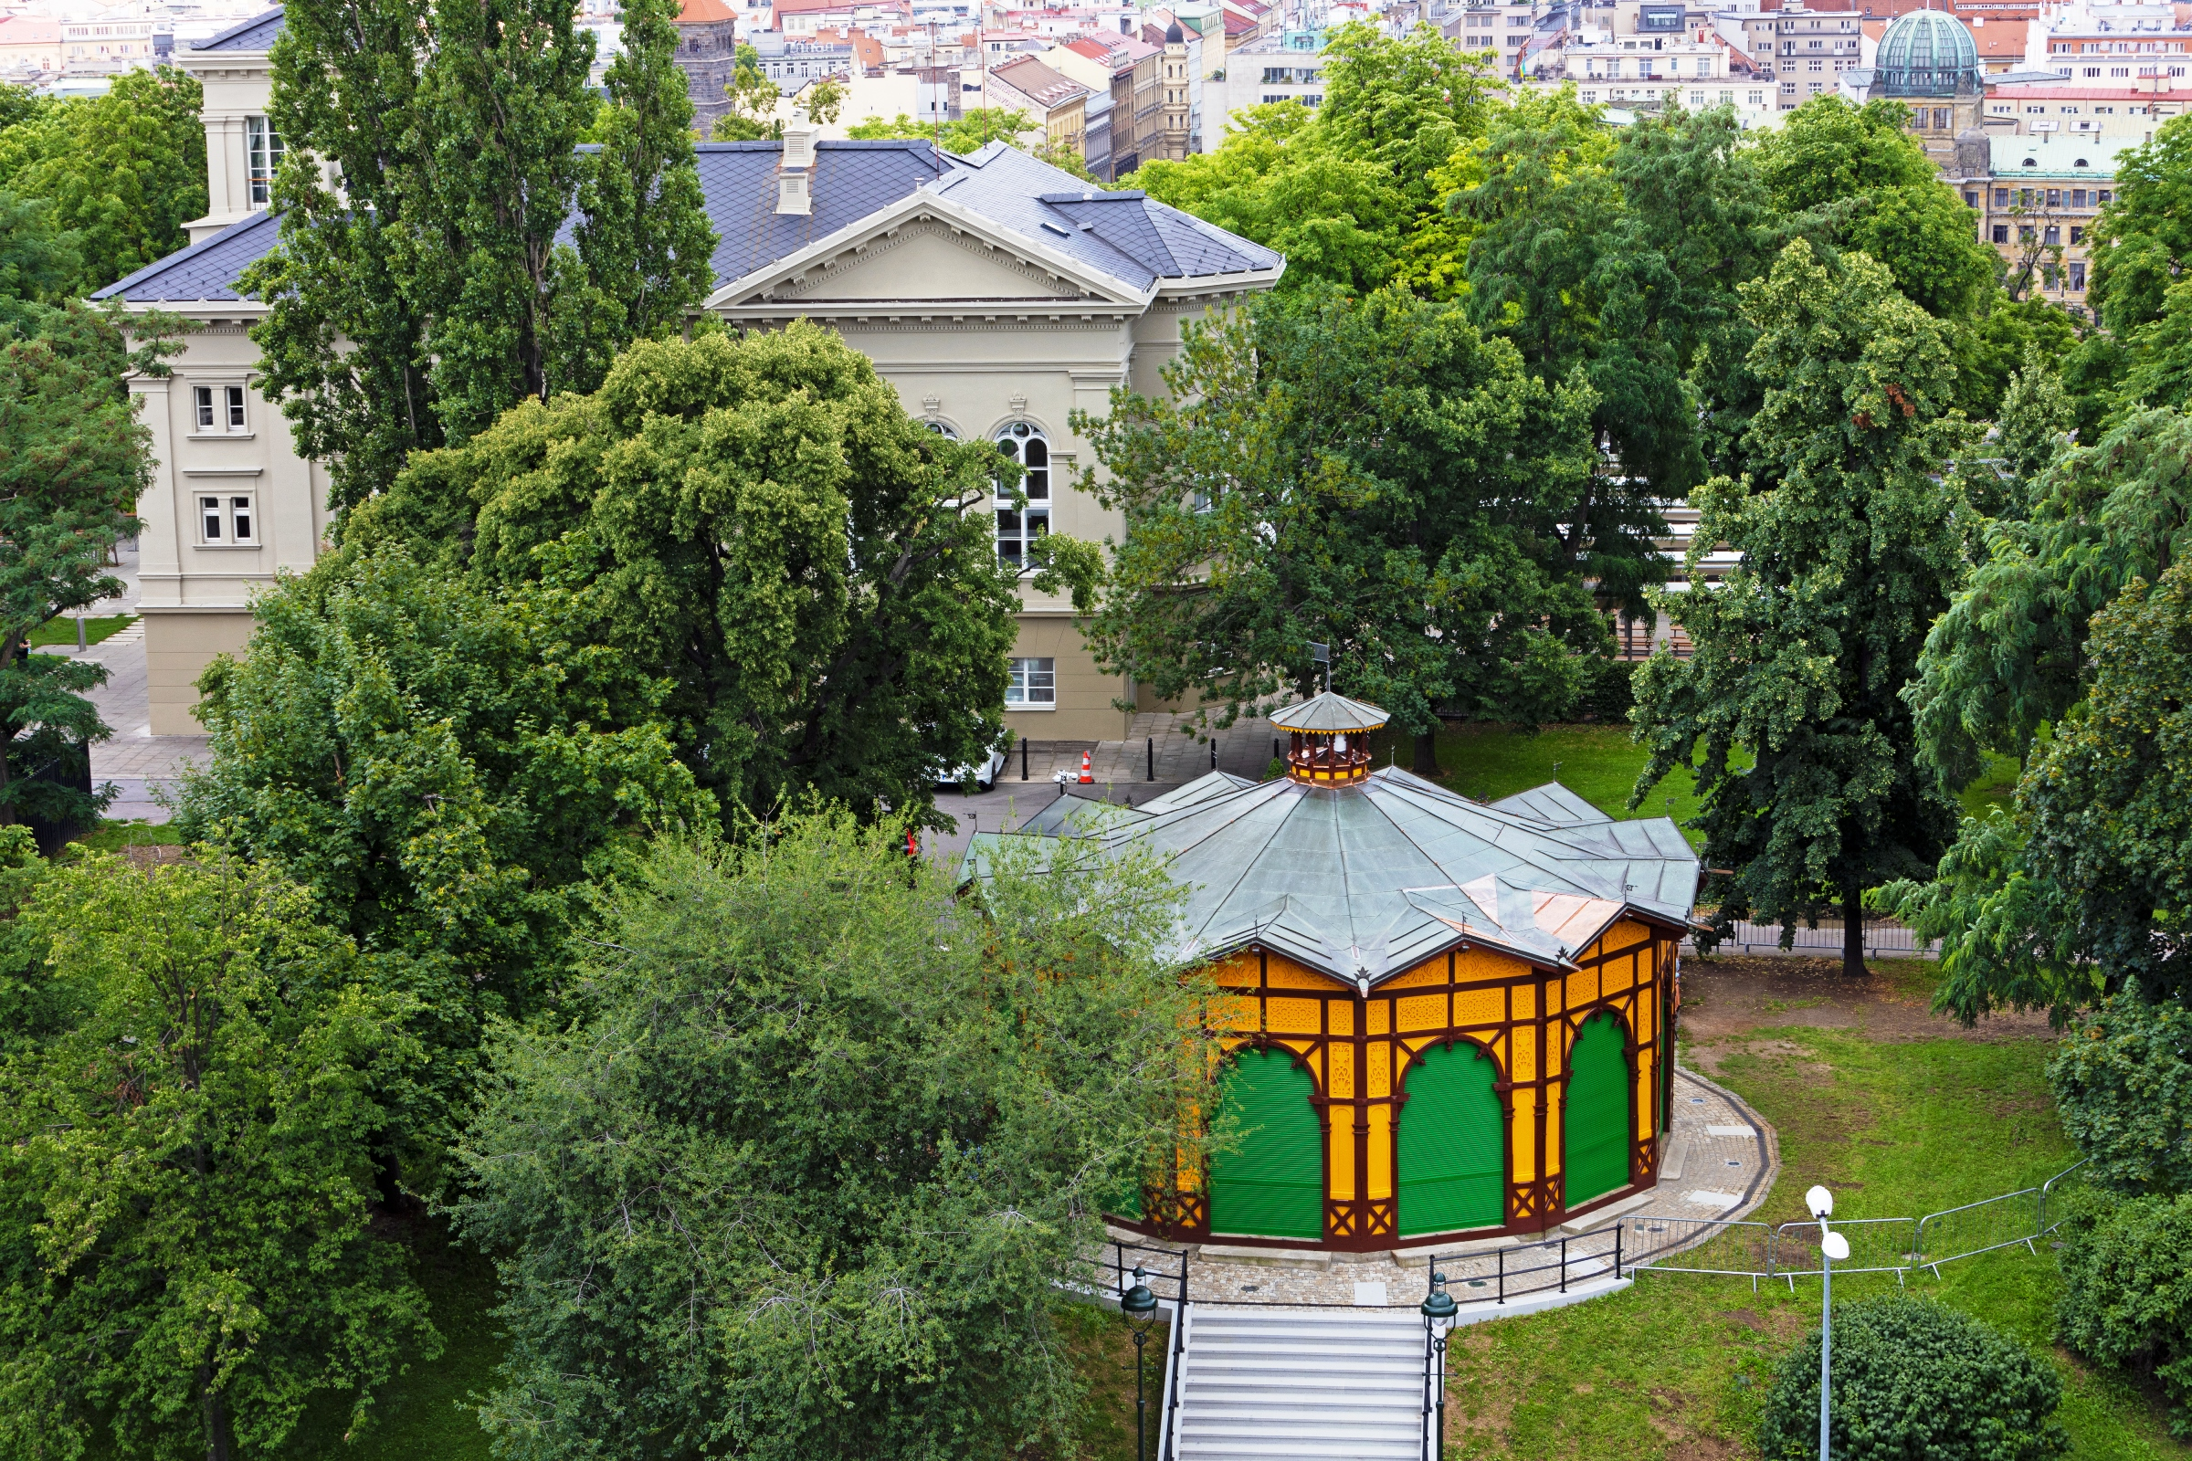
The Letná carousel
Leonard Ceman

Slide 2
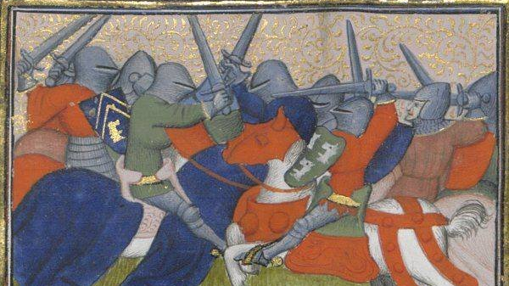
History of carousels
Carrusel, the predecessor of carousels, comes from an italian military game that has spread across Europe at the dawn of the 18. century.
The goal of the game was to hit a target in the center whilst the soldiers were riding around on their horses.
The first mechanichal "carousel" was first documented to be in France in 1662.

Slide 3
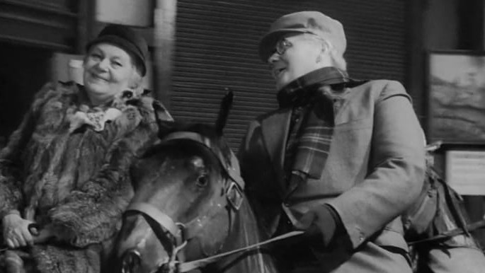
The carousel on Letná
The carousel was built by the owner Josef Nebeský in 1892.
At first the structure stood in Královské Vinohrady – it was probably built for the summer season.
1894 – the entire carousel was moved to Letná neighboring the Electric railway of František Křižík.
Here it was operating until the 1990s – primarily serving as an adult attraction.
Later on the carousel was out of servire due to its devastated condition.

Slide 4
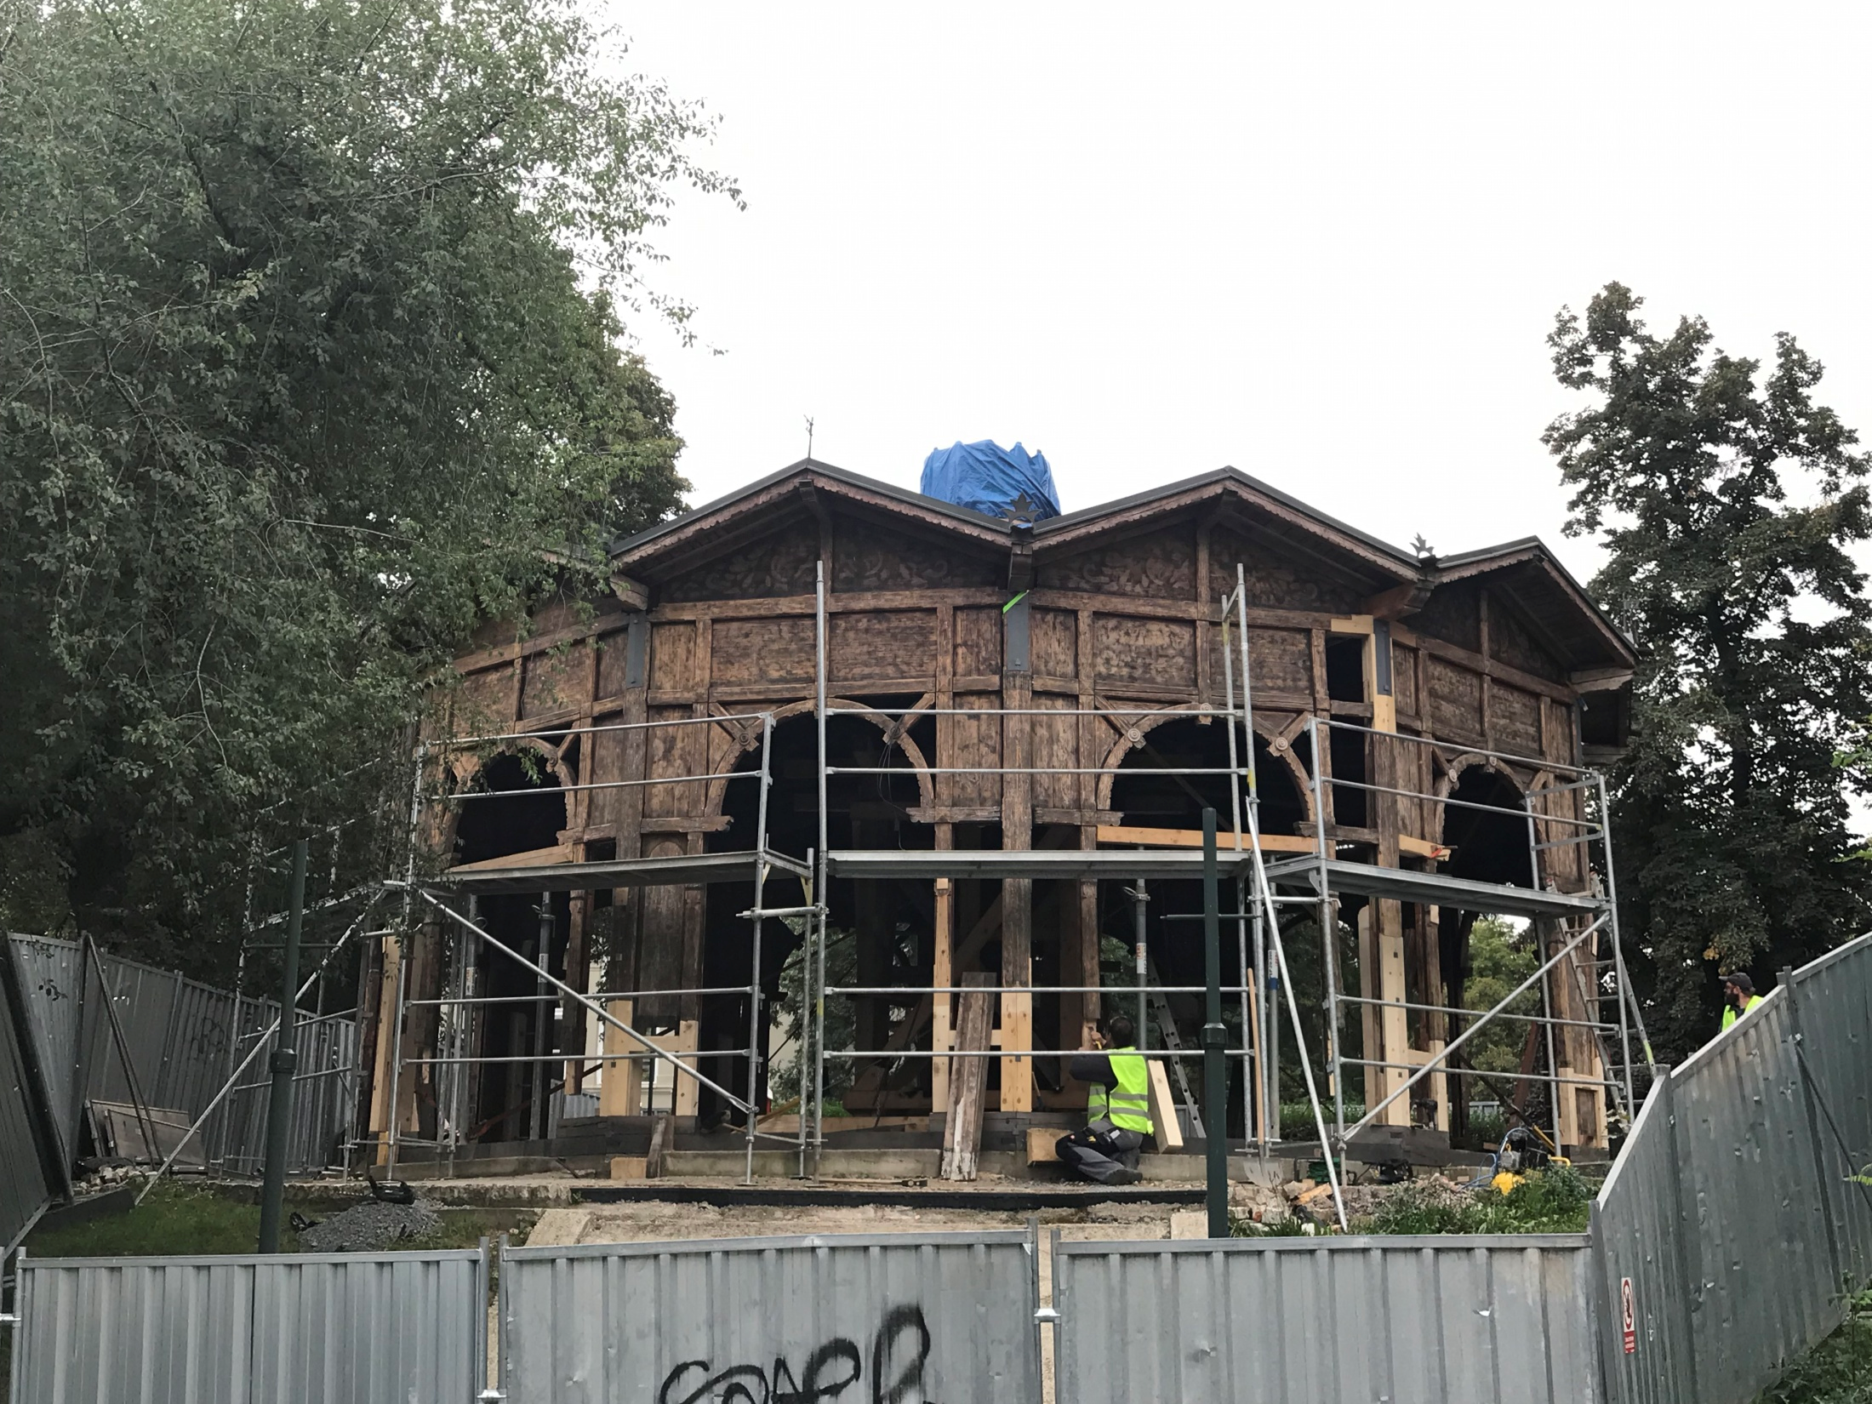
Reconstruction
While inactive, bell and orchestrion "stolen".
2004 – the carousel was bought by the National technical museum.
The cost of reparation was estimated at 6 million CZK in the year 2006.
Over the next few years to the year 2019 the Museum has raised over 2 million CZK from public donations.
The process was long and slow because there wasn't a suitable construction company willing to help with the repairs. It took so long that the carousel wasn't finished until 2022 at the final cost of over 23 million CZK.

Slide 5
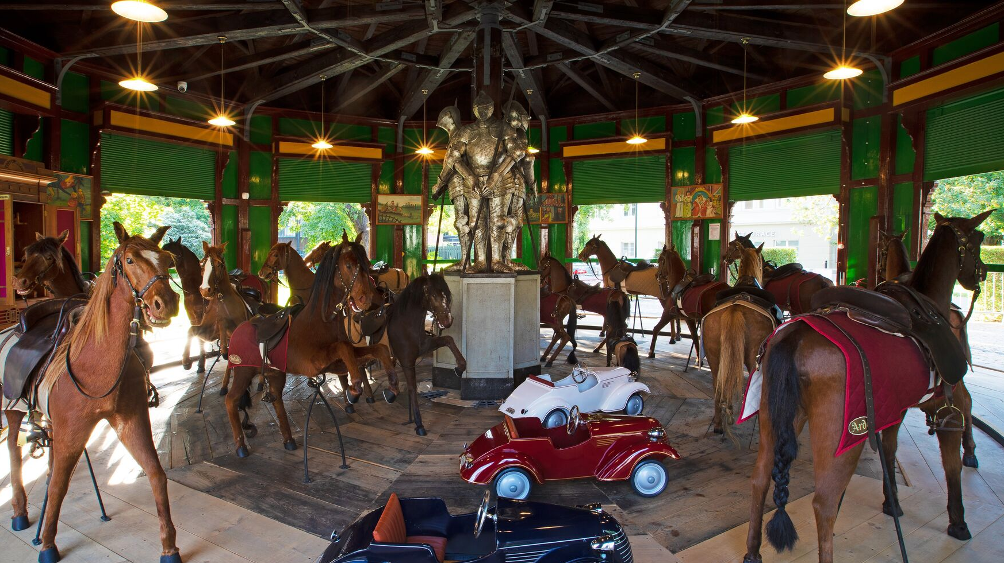
Design
Neo-renaissance style structure with the shape of a dodecagon (12 sides)
Originally 21 horses, but only 18 left after reconstruction work.
Horses covered with real horse leather taken from italian stallions.
Eyes are made from glass
Bodies filled with hay
4 cars - model Aero 30 - have replaced the former benches.
The first form of the carousel still at Vinohrady was propelled by human force
replaced by an electromotor in 1930s

Slide 6
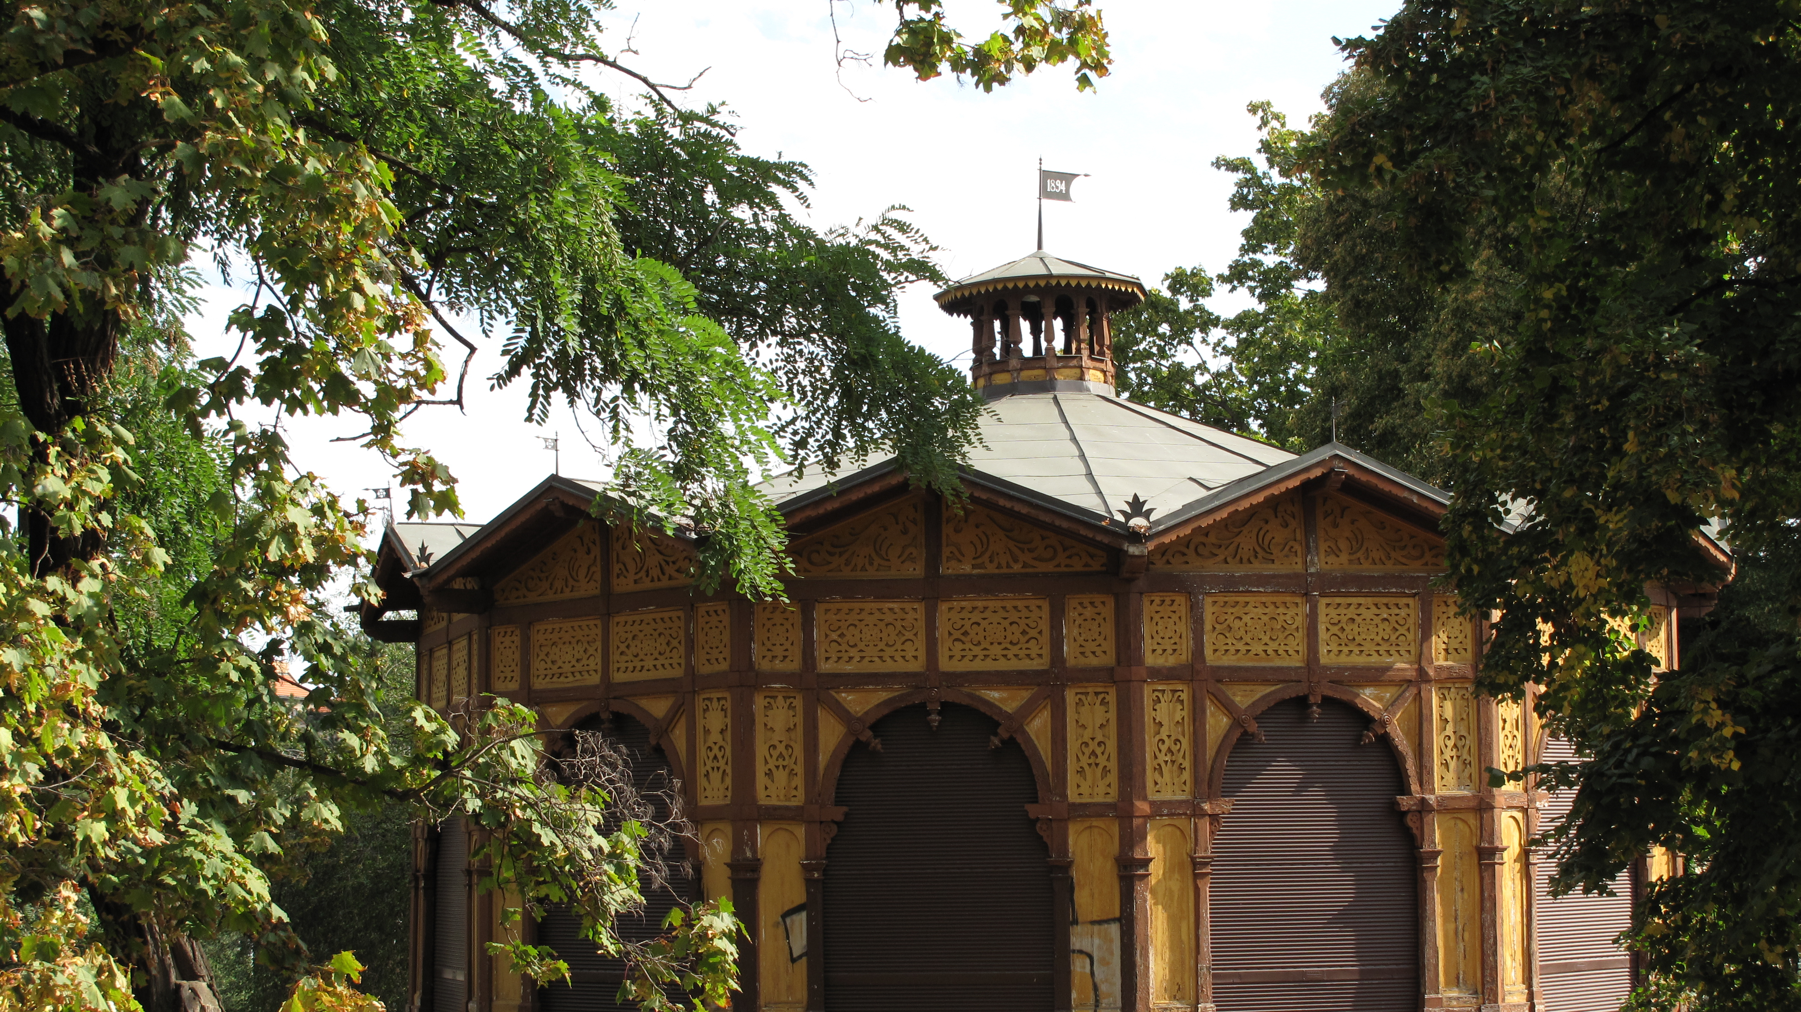
The carousel opens from Friday to Sunday in the afternoon.
Also available in holidays.
Offering a truly unforgetable experience letting you emerge in the old times.
Open for Everyone

Slide 7
Still standing..
After 133 years..
the Letenská carousel still brings a nostalgic feeling to many people and stands to be a symbol of surviving and living through different times and regimes..

Slide 8
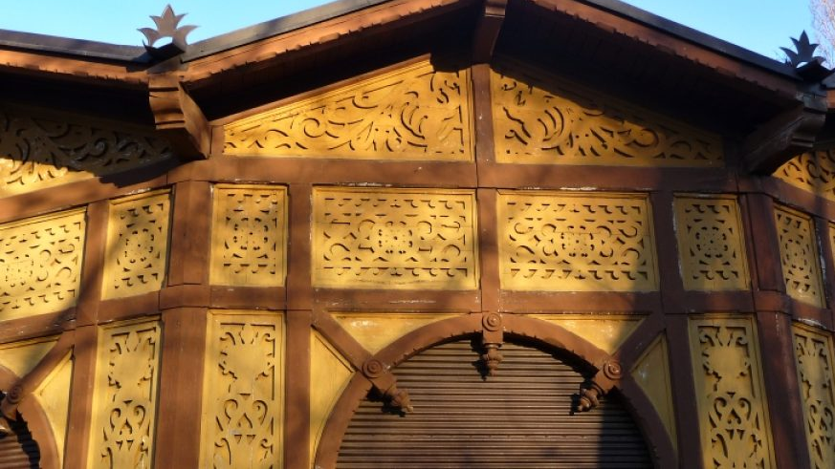
Thank you for your attention.

Slide 9

Sources
https://www.ntm.cz/zakladni-informace/oteviraci-doba/letensky-kolotoc-v-praze
https://www.wikipedia.org/
https://cs.wikipedia.org/
https://www.kudyznudy.cz/aktivity/historicky-kolotoc-na-prazske-letne
https://nasregion.cz/unikatni-historicky-kolotoc-na-prazske-letne-se-uz-toci-282016/

